Slide 1
TYPES OF ANIMALS AND PLANTS

Slide 4
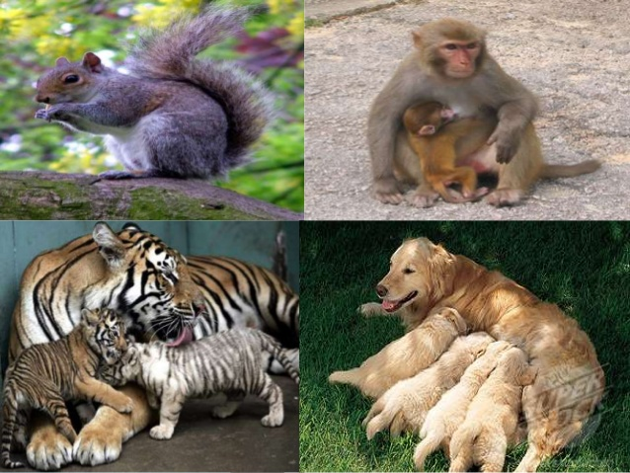

Slide 6
